Slide 1
Building iOS Swift apps
5030-201720_MCS5993_M: 5030-Topics in Computer Science
5031-201720_MCS4993_M: 5031-Topics in MA/CS

Slide 2
Agenda
Appendix B from Nobledesktop book
Customizing the app for iPad

Slide 3
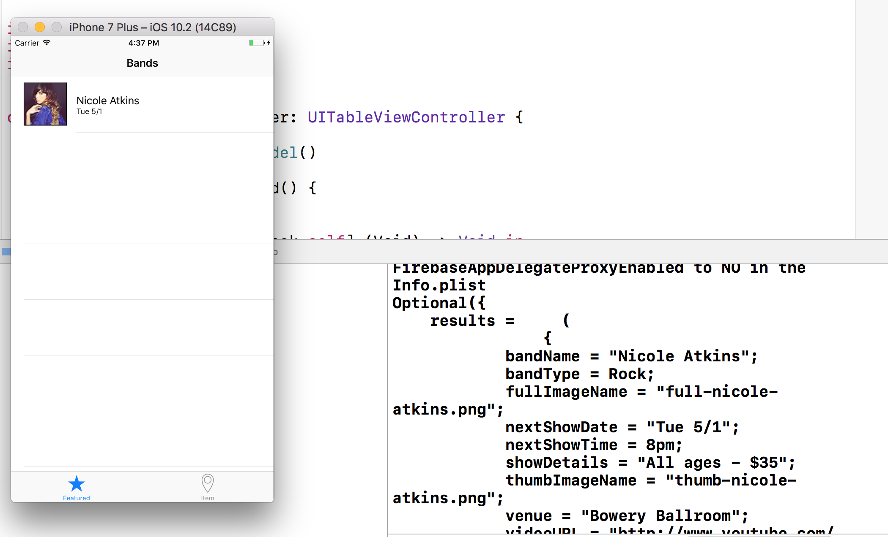
Notes:
For testing purposes, we added a print() function to our model. It should print out
the contents of our Firebase array. This helpful feedback will show up in the Debug
area at the bottom of the screen, so if it isn’t showing, go to the top and click Hide
or show the Debug area .
5. Click Run to fire up the simulator so we can test.
Nicole’s row on the table view should look the same as in previous exercises. That’s
because the data is still the same as when we had static data in our model. It’s just
coming from an external datasource on the Internet now.
6. Switch back to Xcode and find the log on the right side of the Debug area.
In our log file you should see the entire results array, which means the whole object
is there. This is our snapshot. All the code we added ensures that Firebase returns all
the objects from the child array and dictionary. Exactly what we want!

Slide 4
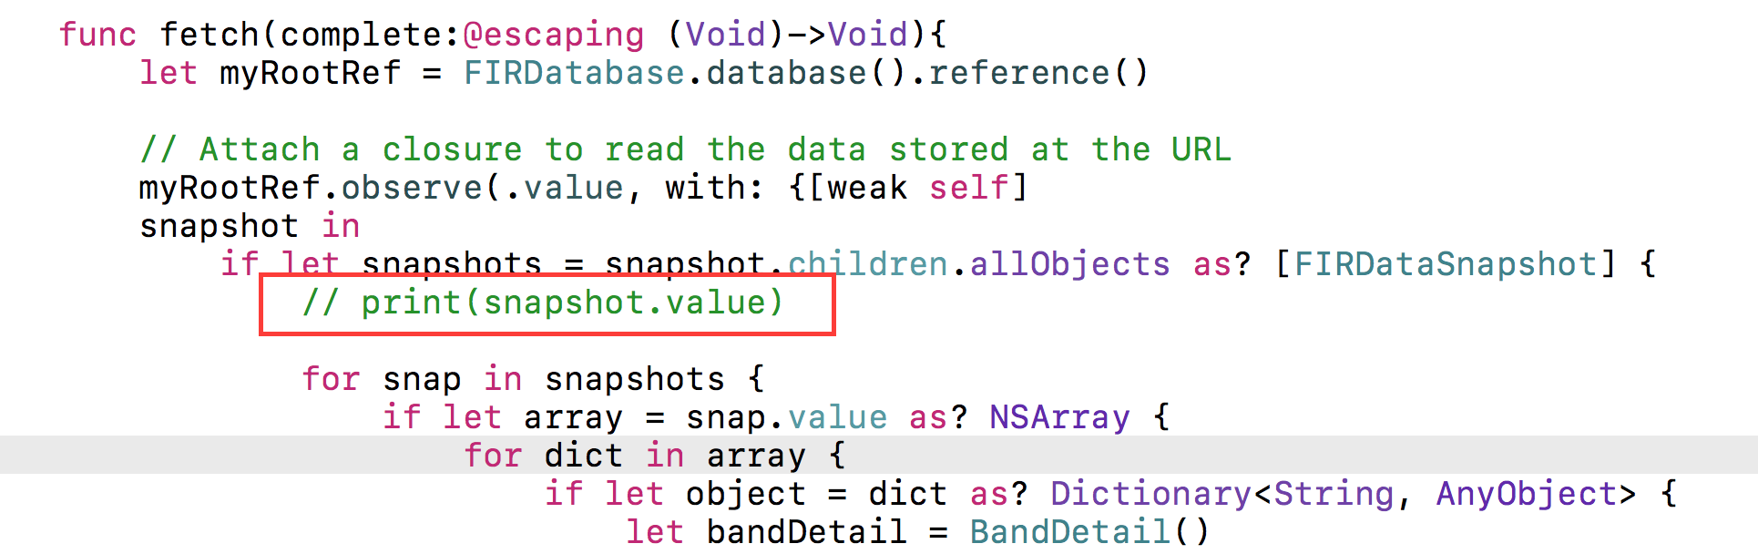
Notes:
Now that we know the code works, we no longer need the print() function. Still in
Xcode, switch to BandsModel.swift.
8. Around line 24, delete the following line of code:
print(snapshot.value)

Slide 5
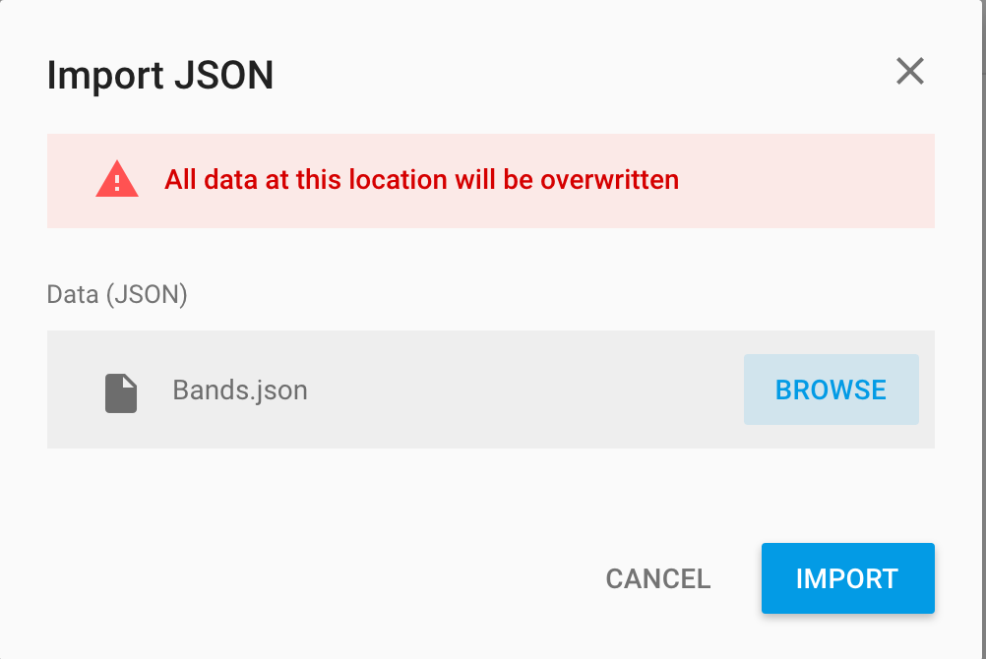
Import More Data
Notes:
Importing More Data
We need to add details for the other three bands. We had you hand-import Nicole’s
data so you could understand how the structure of a database works, and so you
could get your hands wet. But manually typing in data is tedious, and there’s a
better way.
JSON, short for JavaScript Object Notation, is a text format that can share data with
apps or sites written in any language. It is the current standard for data transfer via
REST APIs. Firebase allows us to import data directly from a JSON file.
The Firebase data we already have is structured just like JSON, which is organized as
one parent object (like our results array), followed by other arrays (which can have
key-value pairs nested within). This means that all it takes to get more data into our
app is simply to import our data in JSON format. Let’s check it out to make sure.
1. Return to Firebase in your browser, and in the Data Dashboard, click on the Import
Data button in the top right of the page.
2. In the dialog that pops up, click Choose File.
3. Navigate to Desktop > Class Files > yourname-iOS Dev Level 2 Class > Code
Snippets and double–click on Bands.json to select it.
4. With the file chosen, now click Import JSON.
IOS

Slide 6
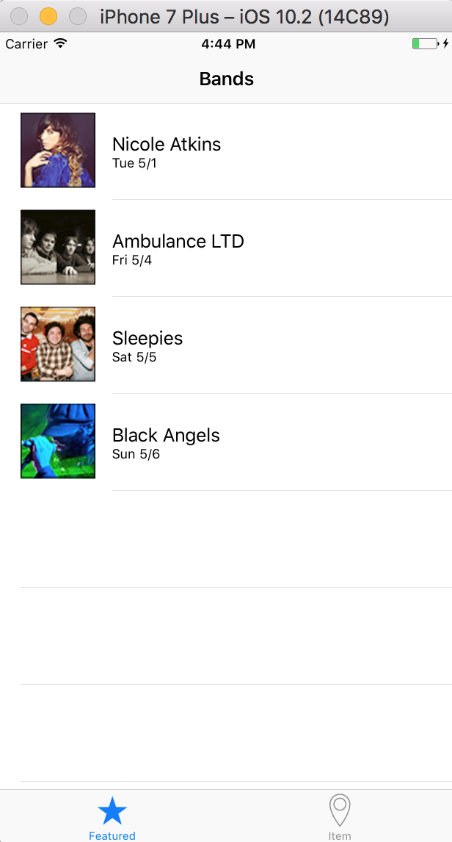
Import More Data
Notes:
You should be returned to the dashboard, where the new data will appear. Expand
the new arrays named 1, 2, and 3 to see key-value pairs for each new band.
6. Let’s see what the app looks like now. Return to Xcode.
7. Click Run to see the app now has all four bands included.
8. Great! Now we have a fully-functioning, real world app that is using an external
datasource. Take a few minutes to experiment with your data on Firebase

Slide 7
Save your work
git add .
git commit –m “Firebased”

Slide 8
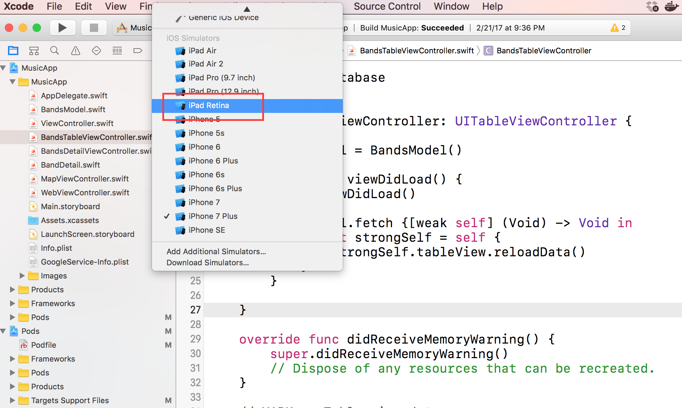
Notes:
Before we make any changes, let’s take a look at how our app currently looks on an
iPad. At the top left of Xcode, click on iPhone 6 and change the active scheme to
iPad Retina.
3. Click the Run button.

Slide 9
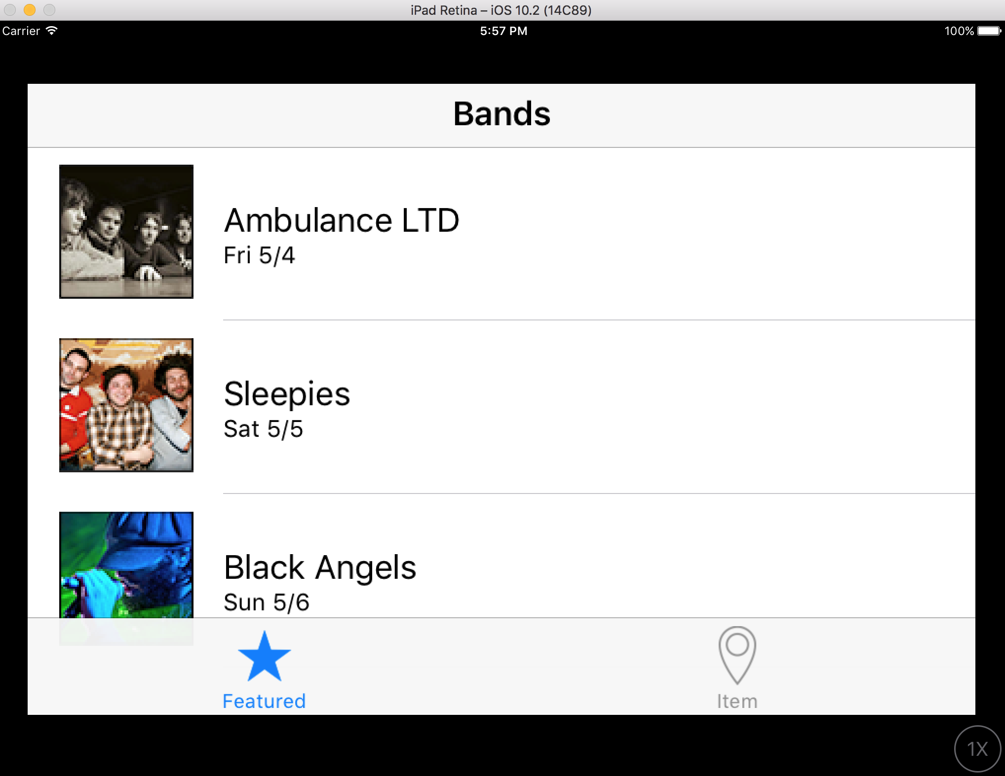
Notes:
When the Simulator finishes loading, notice the app isn’t quite sized right. Even
though we’re running the iPad Simulator, the build settings on our app are specific
to iPhone.
NOTE: You may need to scroll around the window to see the whole app if the
preview is too large for your screen.

Slide 10
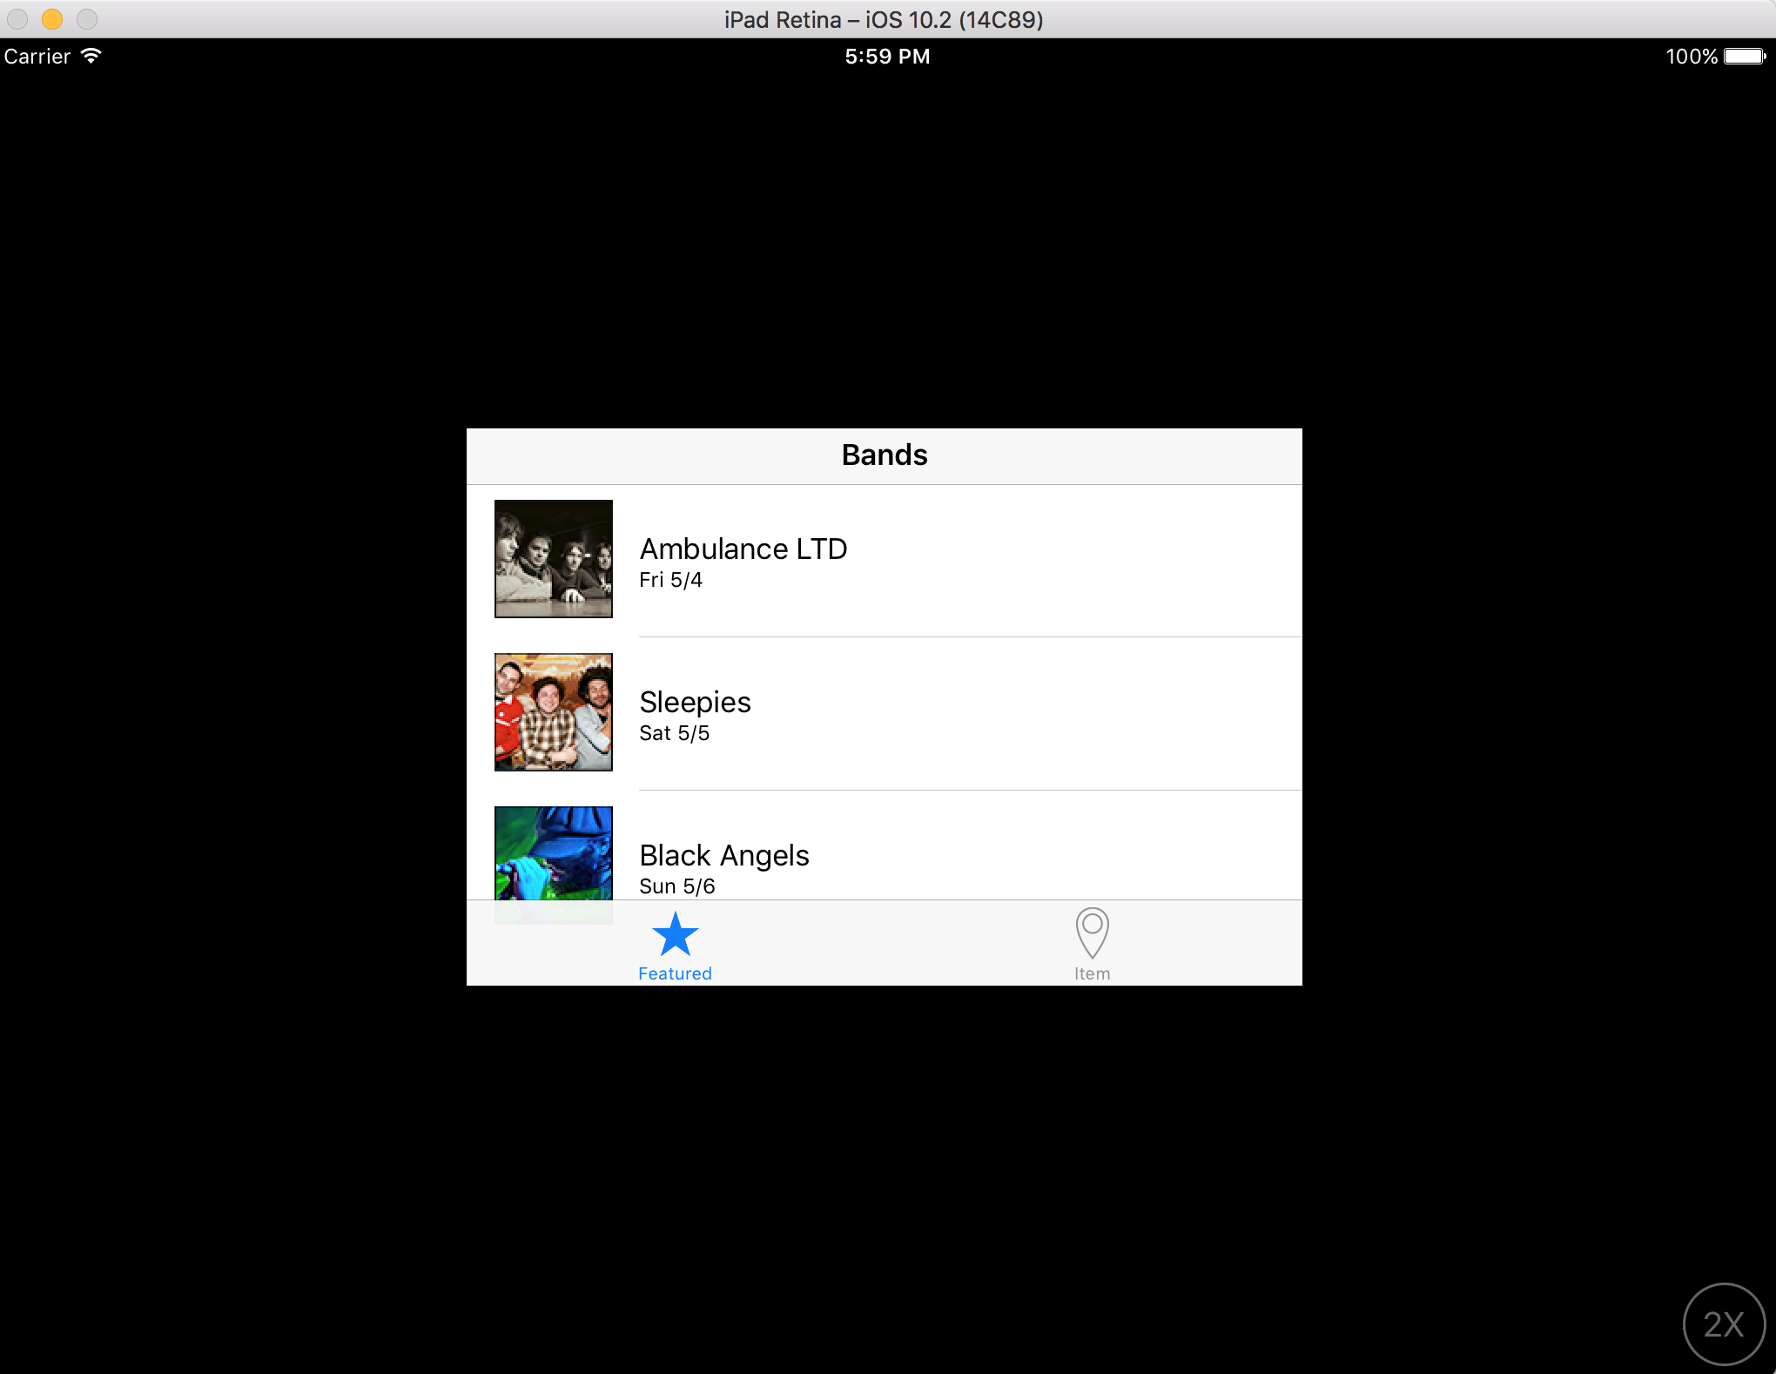
Notes:
In the bottom right corner, click on the 1X button, then click on the 2X button to see
it at 2x again. Notice that it appears to be low-resolution at 2X. That’s because, as
we mentioned, it’s set for iPhone size. The 2X button just scales up the app. While
the app functions, we can make it a lot better than this.

Slide 11
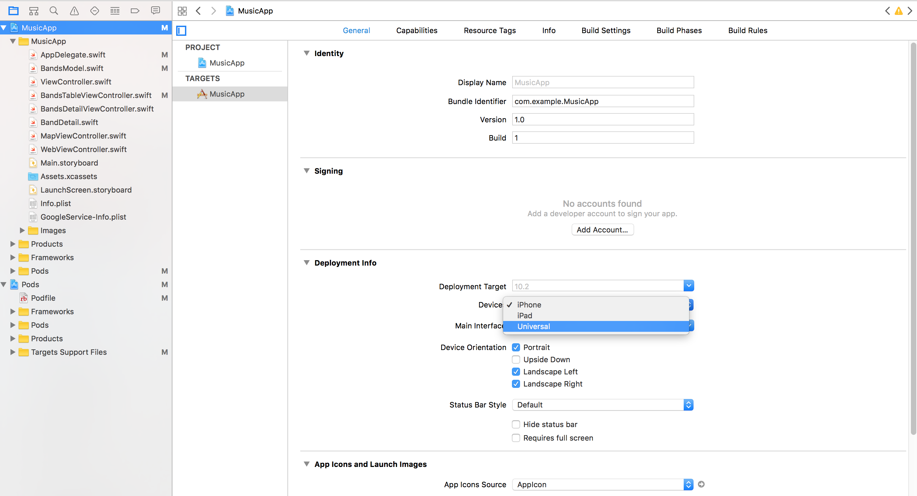
Notes:
Switch back to Xcode.
We want to create a universal app for both iPhone and iPad. We can actually use the
code that we’ve written so far for both by making a few changes.
8. Click the Project Navigator tab if you’re not already in it.
9. Click on the Jive Factory project name (not the folder) at the top of the Project
Navigator. This opens the Project Settings Editor.
10. Slightly to the right of the Project Navigator, to the left of the General tab, make sure
Jive Factory is selected as a Target.
11. If you are not in the General tab, click on it at the top.
12. In the Deployment Info section, from the Devices menu, change iPhone
to Universal.
13. Let’s see what that did. Click the Run button and click Stop if needed.

Slide 12
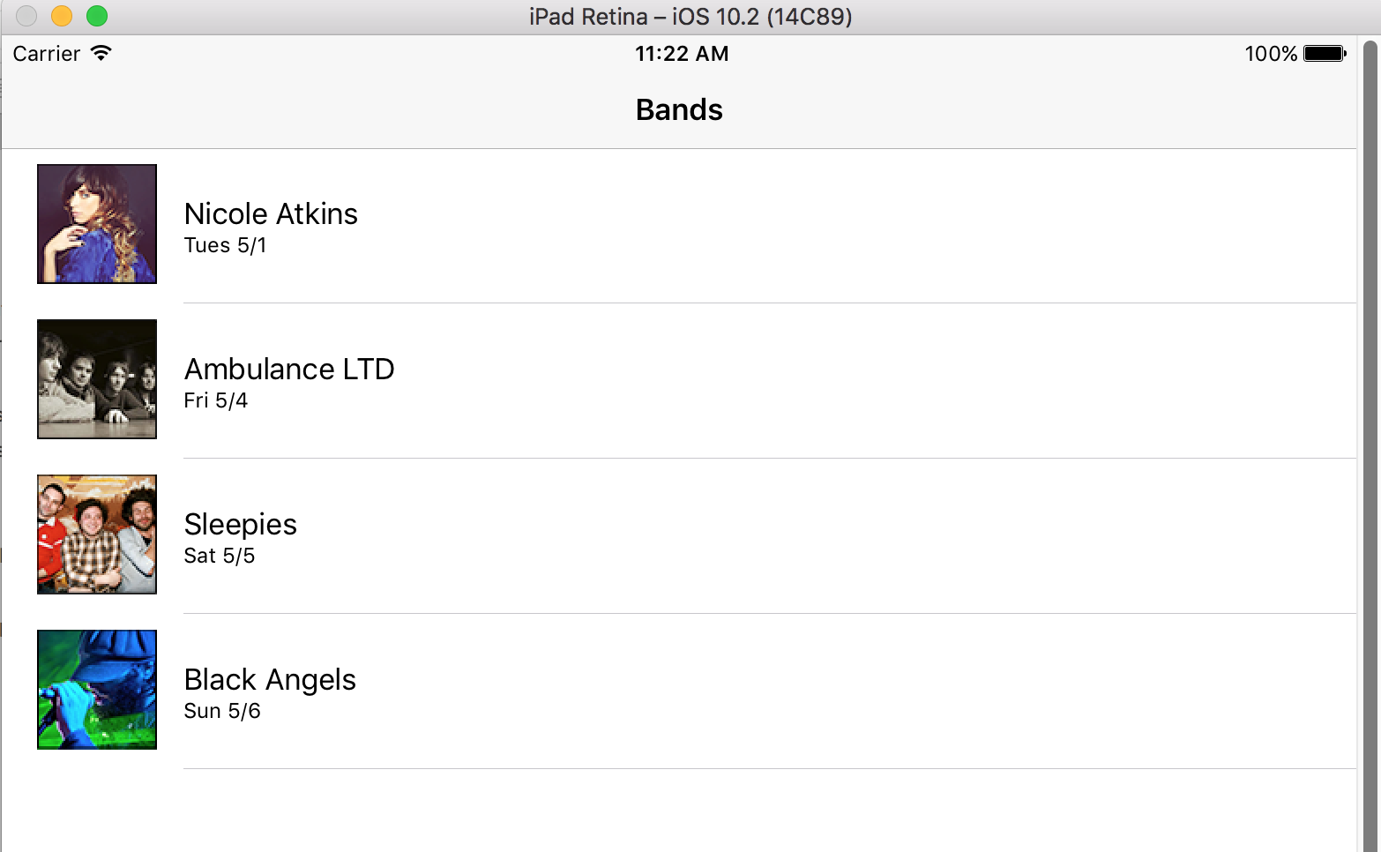

Slide 13
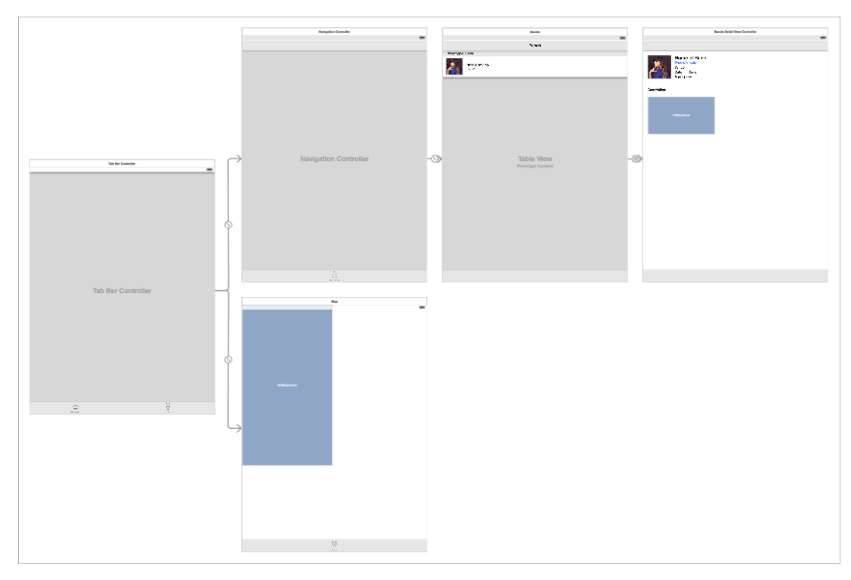
New Storyboard for iPad

Slide 14
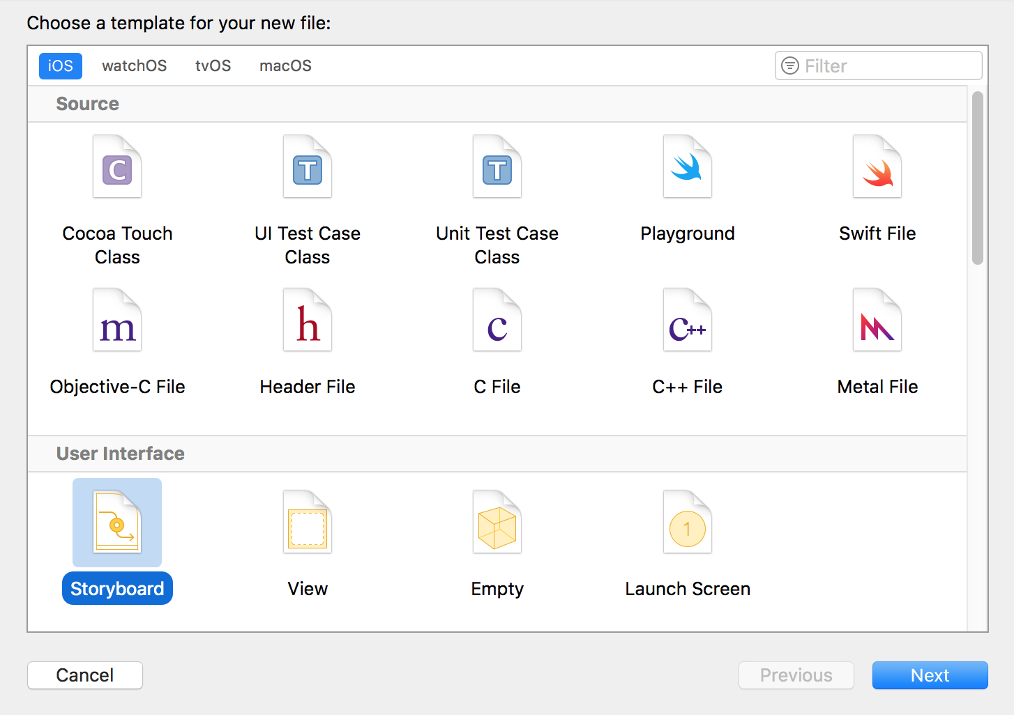
Notes:
In the Project Navigator, click on Main.storyboard. (We want the new storyboard to
come after this file.)
2. Hit Cmd–N to open a new file.
3. In the template dialog, in the left column under iOS, click on User Interface.
4. In the main section of the dialog, double–click on Storyboard.
5. Next to Save As, type: Main_iPad.storyboard
6. You should be in the Jive Factory folder so click Create.

Slide 15
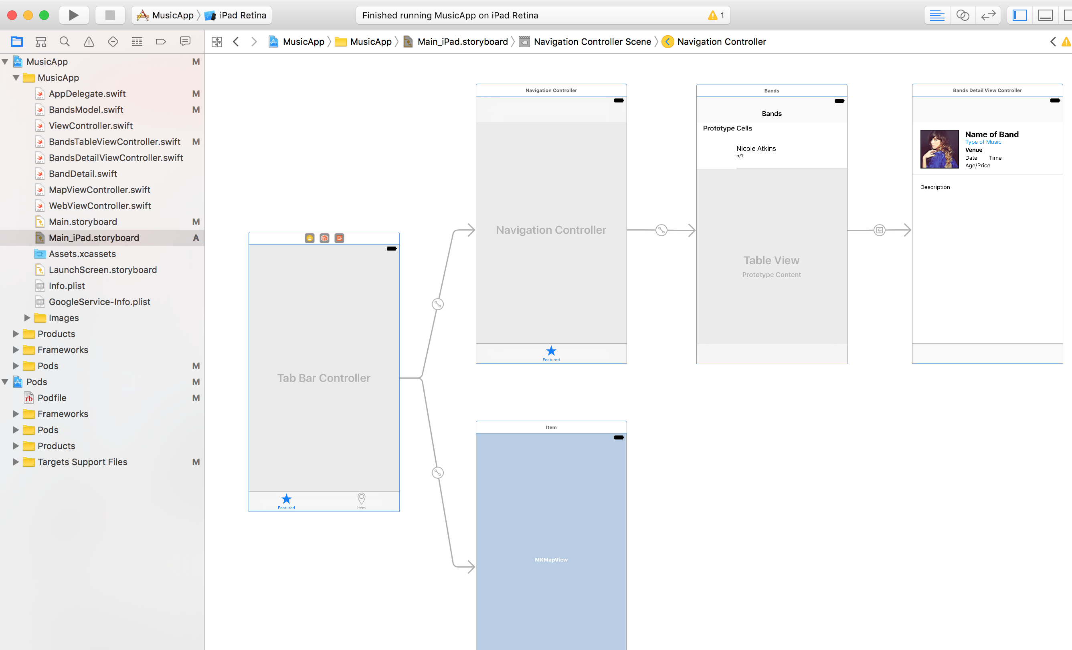
Notes:
7. Let’s copy all the elements from the original iPhone storyboard to our new iPad
storyboard. In the Project Navigator click on Main.storyboard.
8. If the Document Outline is open, click Hide Document Outline .
9. If the Debug area is open, click the Hide the Debug area button at the
top-right corner.
10. Click onto a blank area of the Editor, then press Cmd–A to select all.
11. Press Cmd–C to copy.
12. In the Project Navigator, click on Main_iPad.storyboard.
13. Click onto an empty area of the Editor and hit Cmd–V to paste.
14. Click the Hide Document Outline button .

Slide 16
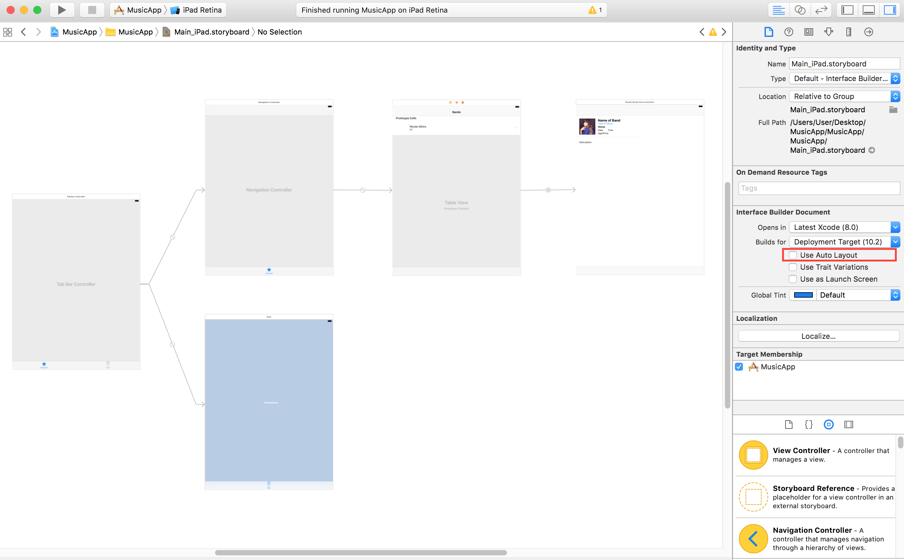
Notes:
Ctrl–click or Right–click on an empty area of the Editor and choose Zoom to 50% so
you can see everything.
16. Click onto a blank area of the Editor to deselect everything.
Click on the file inspector and uncheck Use Auto Layout
Choose iPad storyboard and click disable trait variations

Slide 17
Notes:
Ctrl–click or Right–click on an empty area of the Editor and choose Zoom to 50% so
you can see everything.
16. Click onto a blank area of the Editor to deselect everything.
Click on the file inspector and uncheck Use Auto Layout
Choose iPad storyboard and click disable trait variations

Slide 18
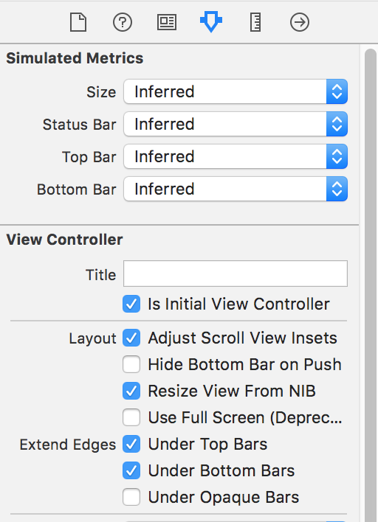
Notes:
We also need to specify the Initial View Controller again. Select the
Tab Bar Controller.
23. In the Attributes inspector tab , in the View Controller section, check on
Is Initial View Controller.

Slide 19
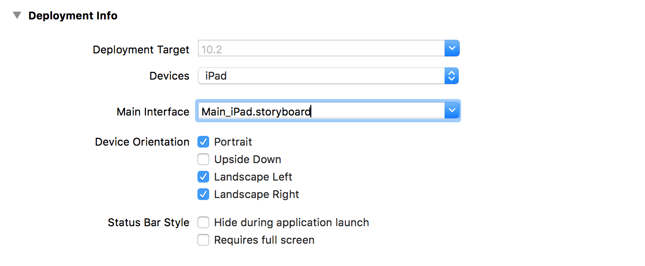
Notes:
24. Now that we have the iPad storyboard, we need to tell the Xcode project to use it
for iPads. In the Project Navigator, click on the Jive Factory project name to open the
Project Settings Editor.
25. In the General tab, in the Deployment Info section, set Devices to iPad.
26. From the Main Interface menu, choose Main_iPad.storyboard.

Slide 20
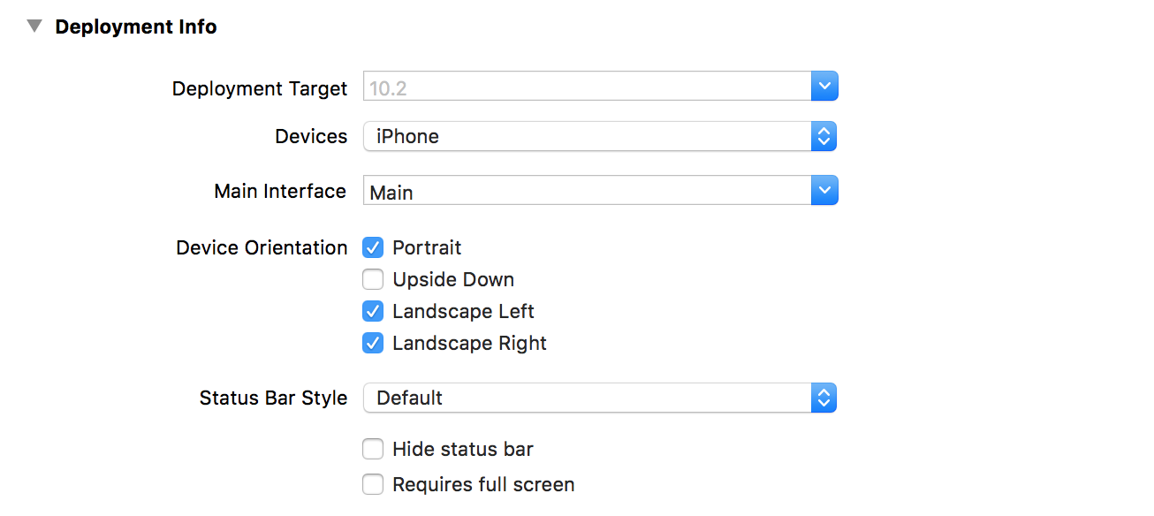
Notes:
Setting the Interface Orientation
For the iPad, it would be nice if we had the bands listed on the left, so that when
one is tapped, the details would load on the right. In the next exercise, we’re going
to use something called a split view controller to do this. The split view controller
works best on a landscape orientation, so we’re going to lock the iPad into landscape
orientation. While we’re at it, let’s also lock the iPhone into portrait orientation
because our app wasn’t designed for landscape on the iPhone.
1. You should still be in the Project Settings Editor. If not, in the Project Navigator, click
on the Jive Factory project name to open the Project Settings Editor.
2. First let’s set the iPhone. Next to Devices, set the menu to iPhone.
3. Next to Device Orientation, we only want Portrait to be checked. If any other
orientations are checked, uncheck them.
4. Now for the iPad. Set Devices to iPad.
5. Click the appropriate orientations on or off so only Landscape Left and
Landscape Right are checked.
6. Click the Run button and click Stop if a warning appears.

Slide 21
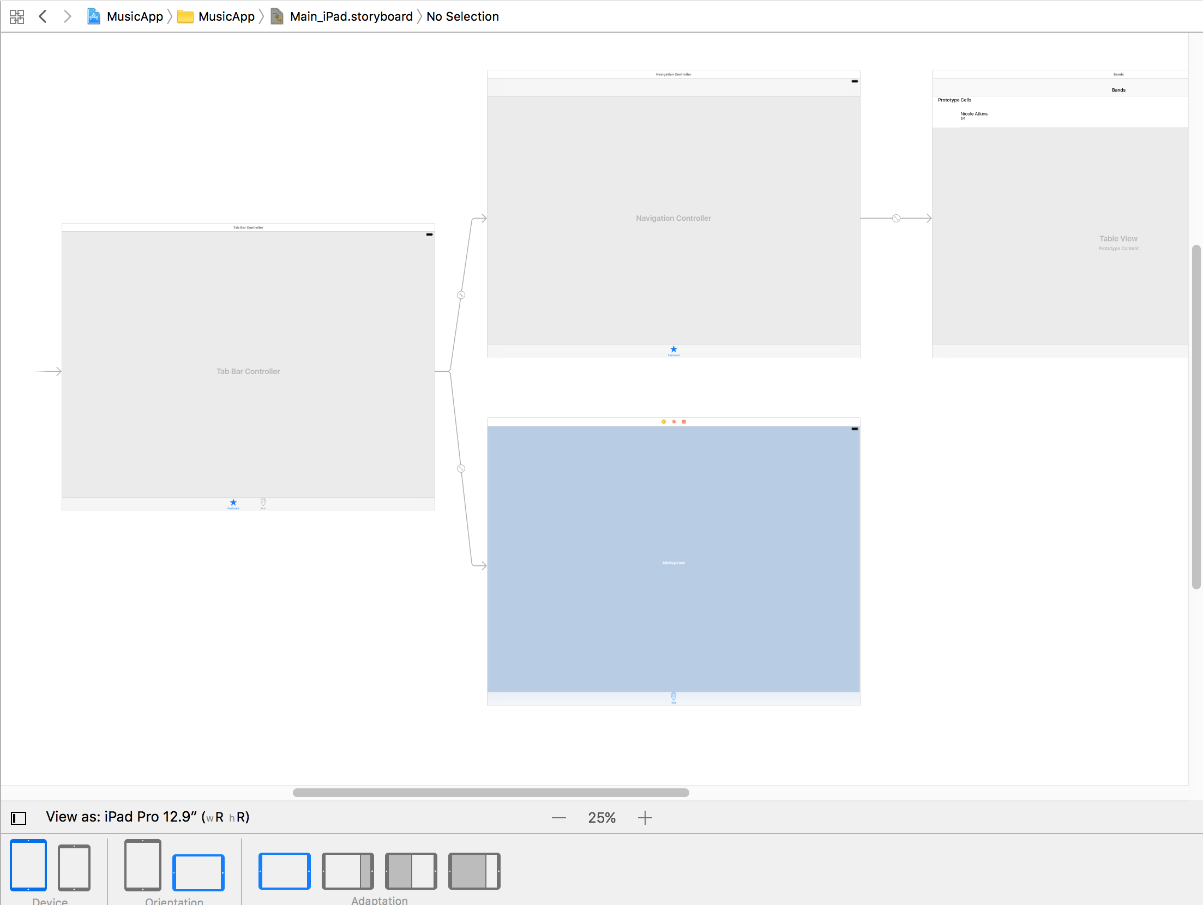
Notes:
In the Project Navigator, click on Main_iPad.storyboard.
12. Notice the controllers still appear in portrait orientation.
Let’s change them to landscape mode. Select the Tab Bar Controller.
Choose Simulator and then click on View As iPad Pro 12.9 with a landscape orientation
Notice all the controllers connected to the Tab Bar Controller have also switched to
landscape mode!
15. The controllers are probably overlapping. Move them apart so they have some space
between them and no longer overlap.
16. Go to File > Save.
Keep this file open. In the next exercise, we’ll make the app look more suitable for
the iPad by adjusting the UI and adding a Split View Controller, which is only
available for the iPad.

Slide 22
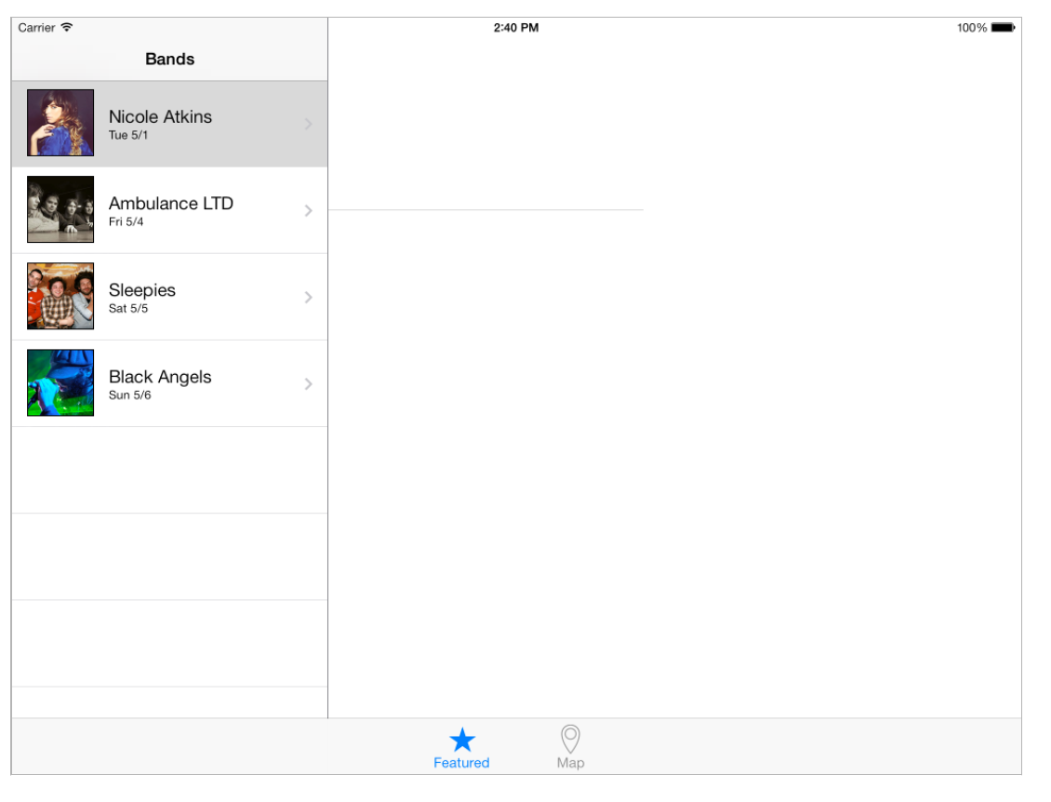
Notes:
Keep this file open. In the next exercise, we’ll make the app look more suitable for
the iPad by adjusting the UI and adding a Split View Controller, which is only
available for the iPad.

Slide 23
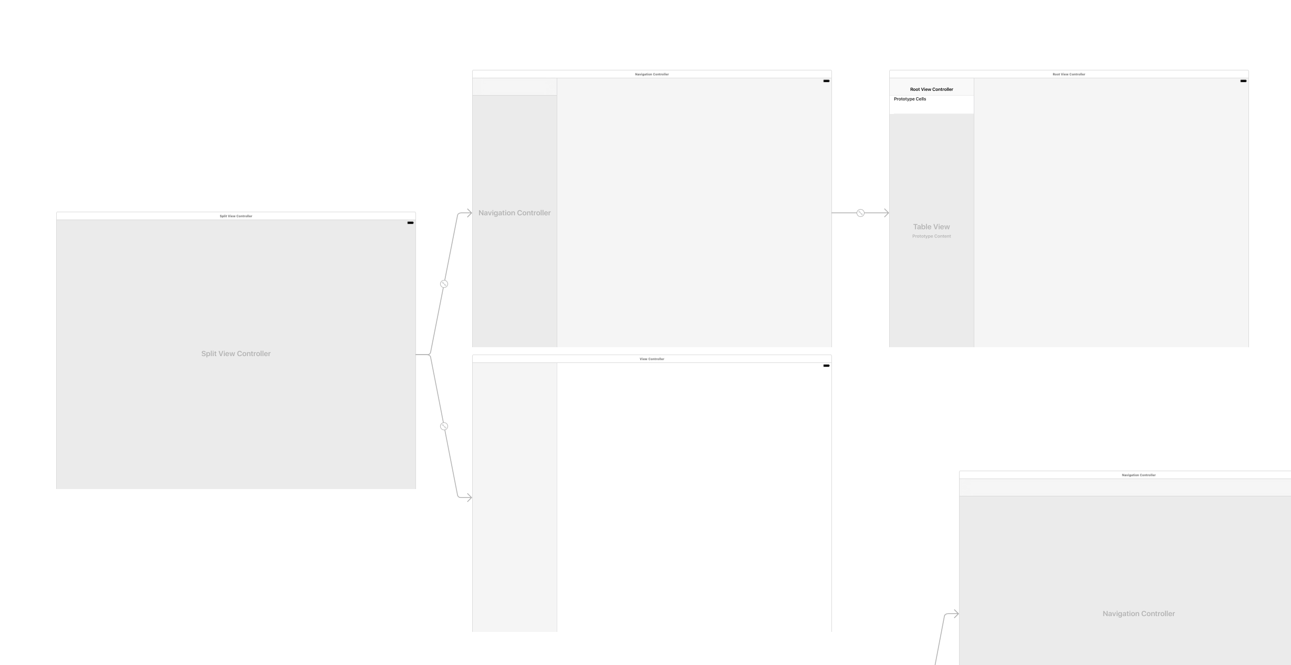
Notes:
In the Project Navigator, click on Main_iPad.storyboard.
2. If the Document Outline is open, click Hide Document Outline .
3. Ctrl–click or Right–click on a blank area of the Editor and choose Zoom to 25%.
4. At the bottom of the Object library search for: split
5. From the Object library , drag a Split View Controller onto the Editor area above
the Tab Bar Controller (which should be the leftmost controller).
6. Click Hide Document Outline if it popped open.
7. Zoom in on the Split View Controller you just added.
8. Notice it comes with a main Split View Controller as well as a Master View
(Navigation Controller and Table View Controller) along with a (Detail)
View Controller.
9. We only need the main Split View Controller (which is on the left). Click on a blank
area of the Editor to deselect all.
10. We want to delete the three views on the right. Click on the top of the
Navigation Controller to select it.

Slide 24
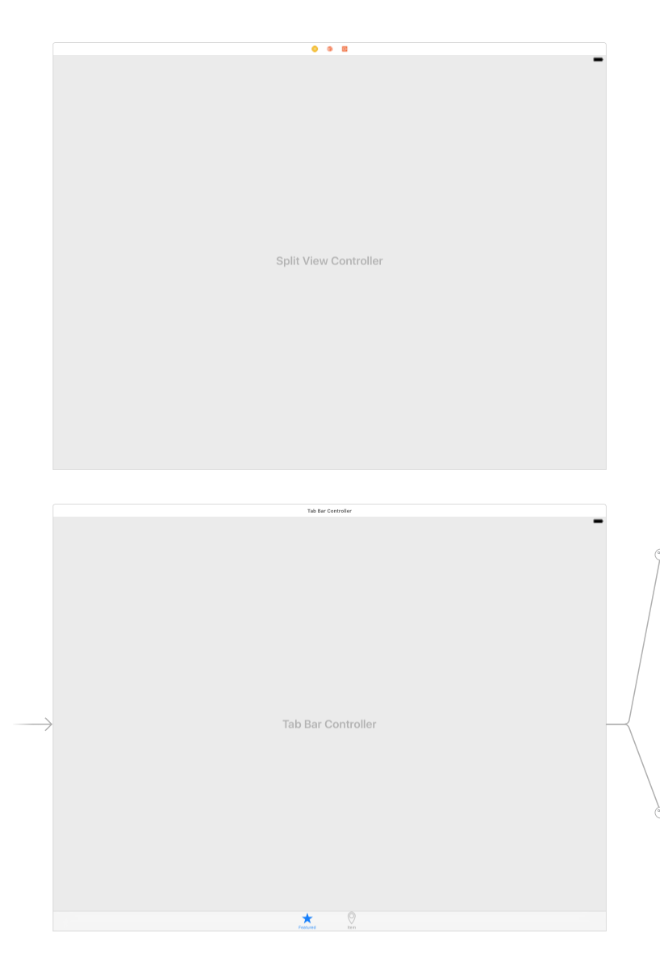
Notes:
11. Hold Shift and click on the top of the Root View Controller.
Hold Shift and click on the top of the View Controller. All three views should be
outlined in blue.
13. With those three views selected, hit Delete.
14. Drag the Split View Controller so it’s nicely positioned above the Tab Bar Controller.

Slide 25
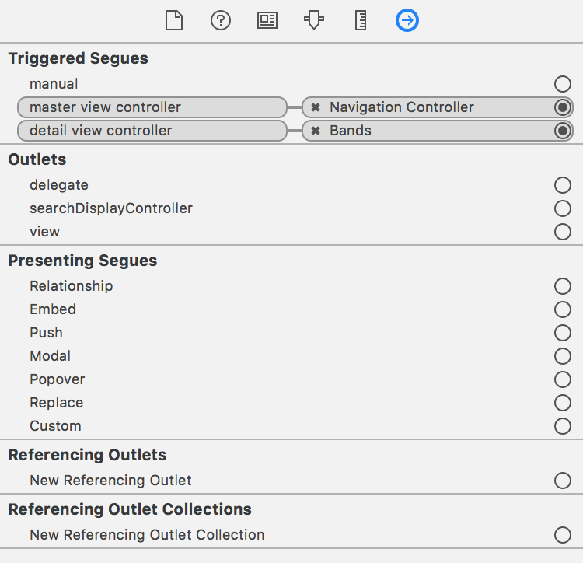
Notes:
In the Editor, make sure you can see both the Navigation Controller (with the
Featured icon on its tab bar) and the new Split View Controller.
2. Click on a blank area of the Editor to deselect everything.
3. Select the Split View Controller. (It shouldn’t be connected to anything now.)
4. In the Utilities area, click on the Connections inspector tab .
5. Under Triggered Segues, hover over the circle to the far right of master view
controller. A + sign will appear in the circle.
6. Drag from the + to the Navigation Controller (with the Featured icon on its tab bar)
in the Editor area.
Scroll over in the Editor so you can see that the Bands Table View Controller and the
Bands Detail View Controller have resized. That indicates they will be displayed on
the left side of the Split View Controller. (Don’t worry about repositioning them in
the Editor yet, we’ll clean up the arrangement later.)
8. In the Editor make sure you can see the Bands Detail View Controller. It has the
Name of Band and other info on it, and it should be the rightmost controller.
9. We don’t want the Bands Detail View Controller to be displayed on the left side of
the Split View Controller. We want this to be displayed on the right side. With the
Split View Controller still selected, under Triggered Segues, hover over the circle to
the far right of detail view controller. A + sign will appear in the circle.
10. Drag from the + to the Bands Detail View Controller in the Editor area.
The Triggered Segues should now look like this:

Slide 26
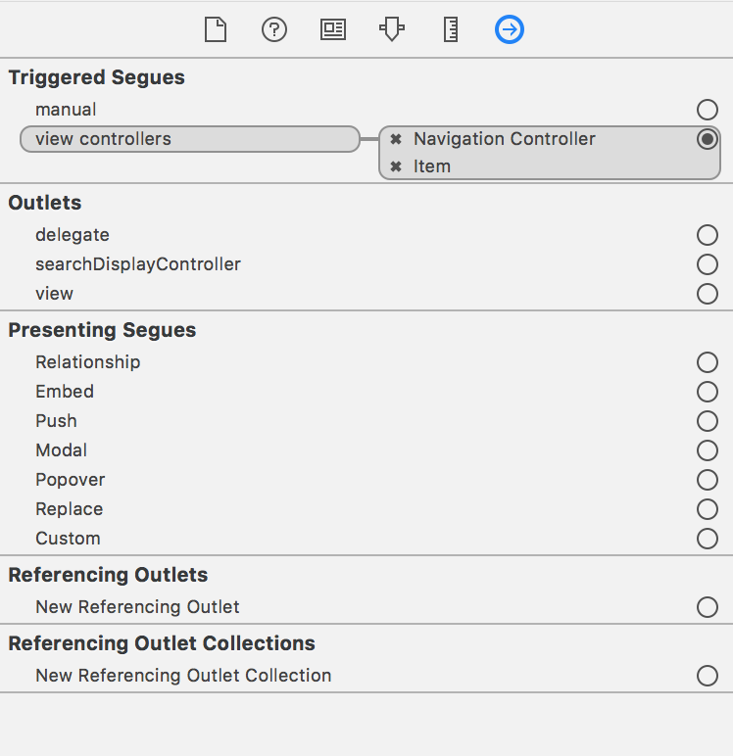
Notes:
Select the Tab Bar Controller.
It should be to the far left, under the Split View Controller.
12. In the Connections inspector notice that under Triggered Segues, view controllers is connected to two controllers currently: Navigation Controller and Map.
We want to add the new Split View Controller to this list, but we need to add the
View Controllers in the order that we want their tabs to appear. Because we want to
add the Split View Controller at the top of the list, we need to delete the connections
to all the controllers and re-add them all in the preferred order. Click the x to the left
of both of the following to delete them:
• Navigation Controller
• Map

Slide 27
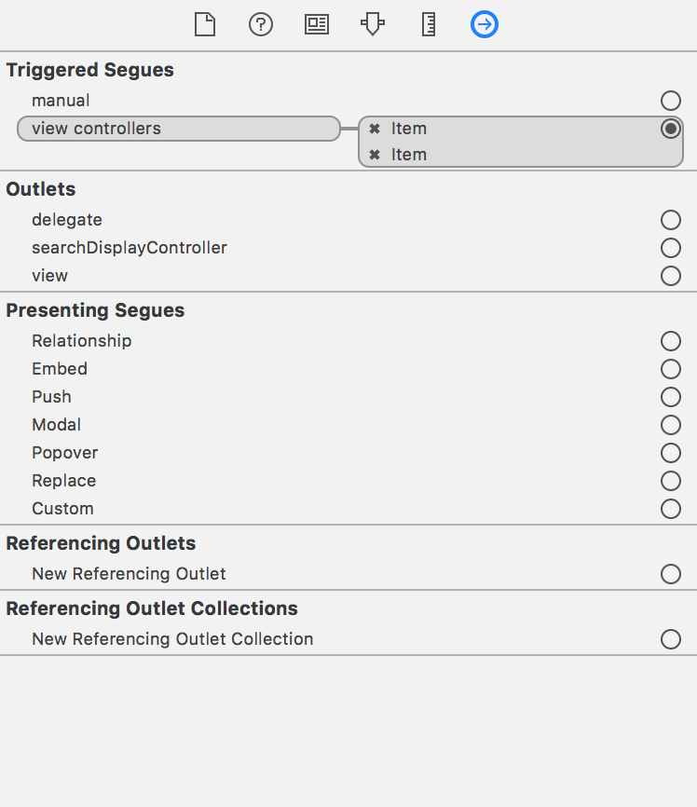
Notes:
With the Tab Bar Controller still selected, under Triggered Segues, hover over the
circle to the far right of view controllers. A + sign will appear in the circle.
15. Drag from the + to the Split View Controller.
16. Make sure you can see the Map View Controller. It should be to the lower right of
the Tab Bar Controller.
17. With the Tab Bar Controller still selected, under Triggered Segues, hover over the
circle to the far right of view controllers. A + sign will appear in the circle.
18. Drag from the + to the Map View Controller.
NOTE: We don’t need to add the Navigation Controller because it’s now part of the
Split View Controller.
19. The Triggered Segues section in the Connections inspector should now look like this:

Slide 28
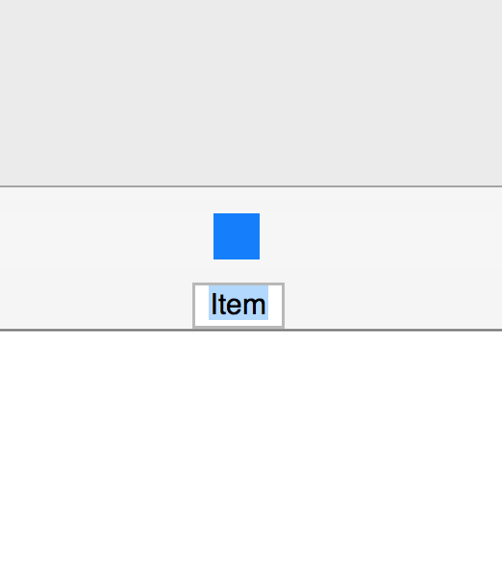
Notes:
Fixing the Tab Bar Icon
We need to add the custom tab bar icon for the Split View Controller.
1. Zoom in on the Split View Controller in the Editor. (Ctrl–click or Right–click on a
blank area of the Editor and choose Zoom to 100%.)
2. Click on the tab bar icon (solid gray rectangle) so it gets highlighted in blue.
NOTE: Depending on your settings, you may have a gray box with Item hidden
“behind” it, as shown below. Regardless, clicking on the bottom of the gray box
should allow you to proceed to the next step.

Slide 29
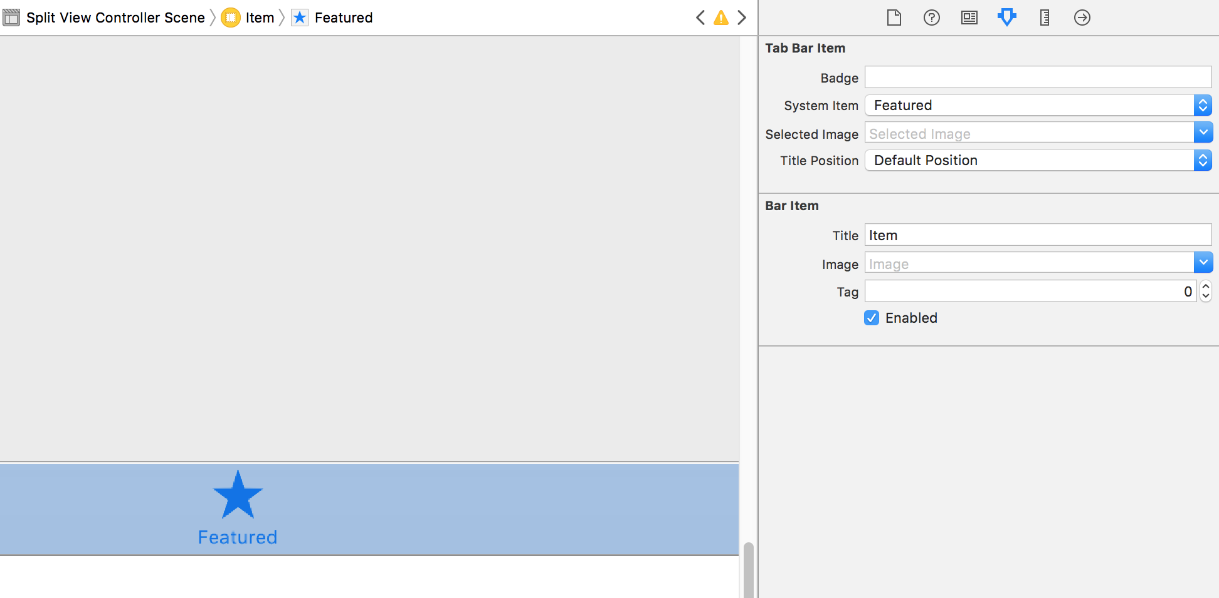
Notes:
From the System Item menu, choose Featured.
Notice the new Featured tab bar icon on the Split View Controller.

Slide 30
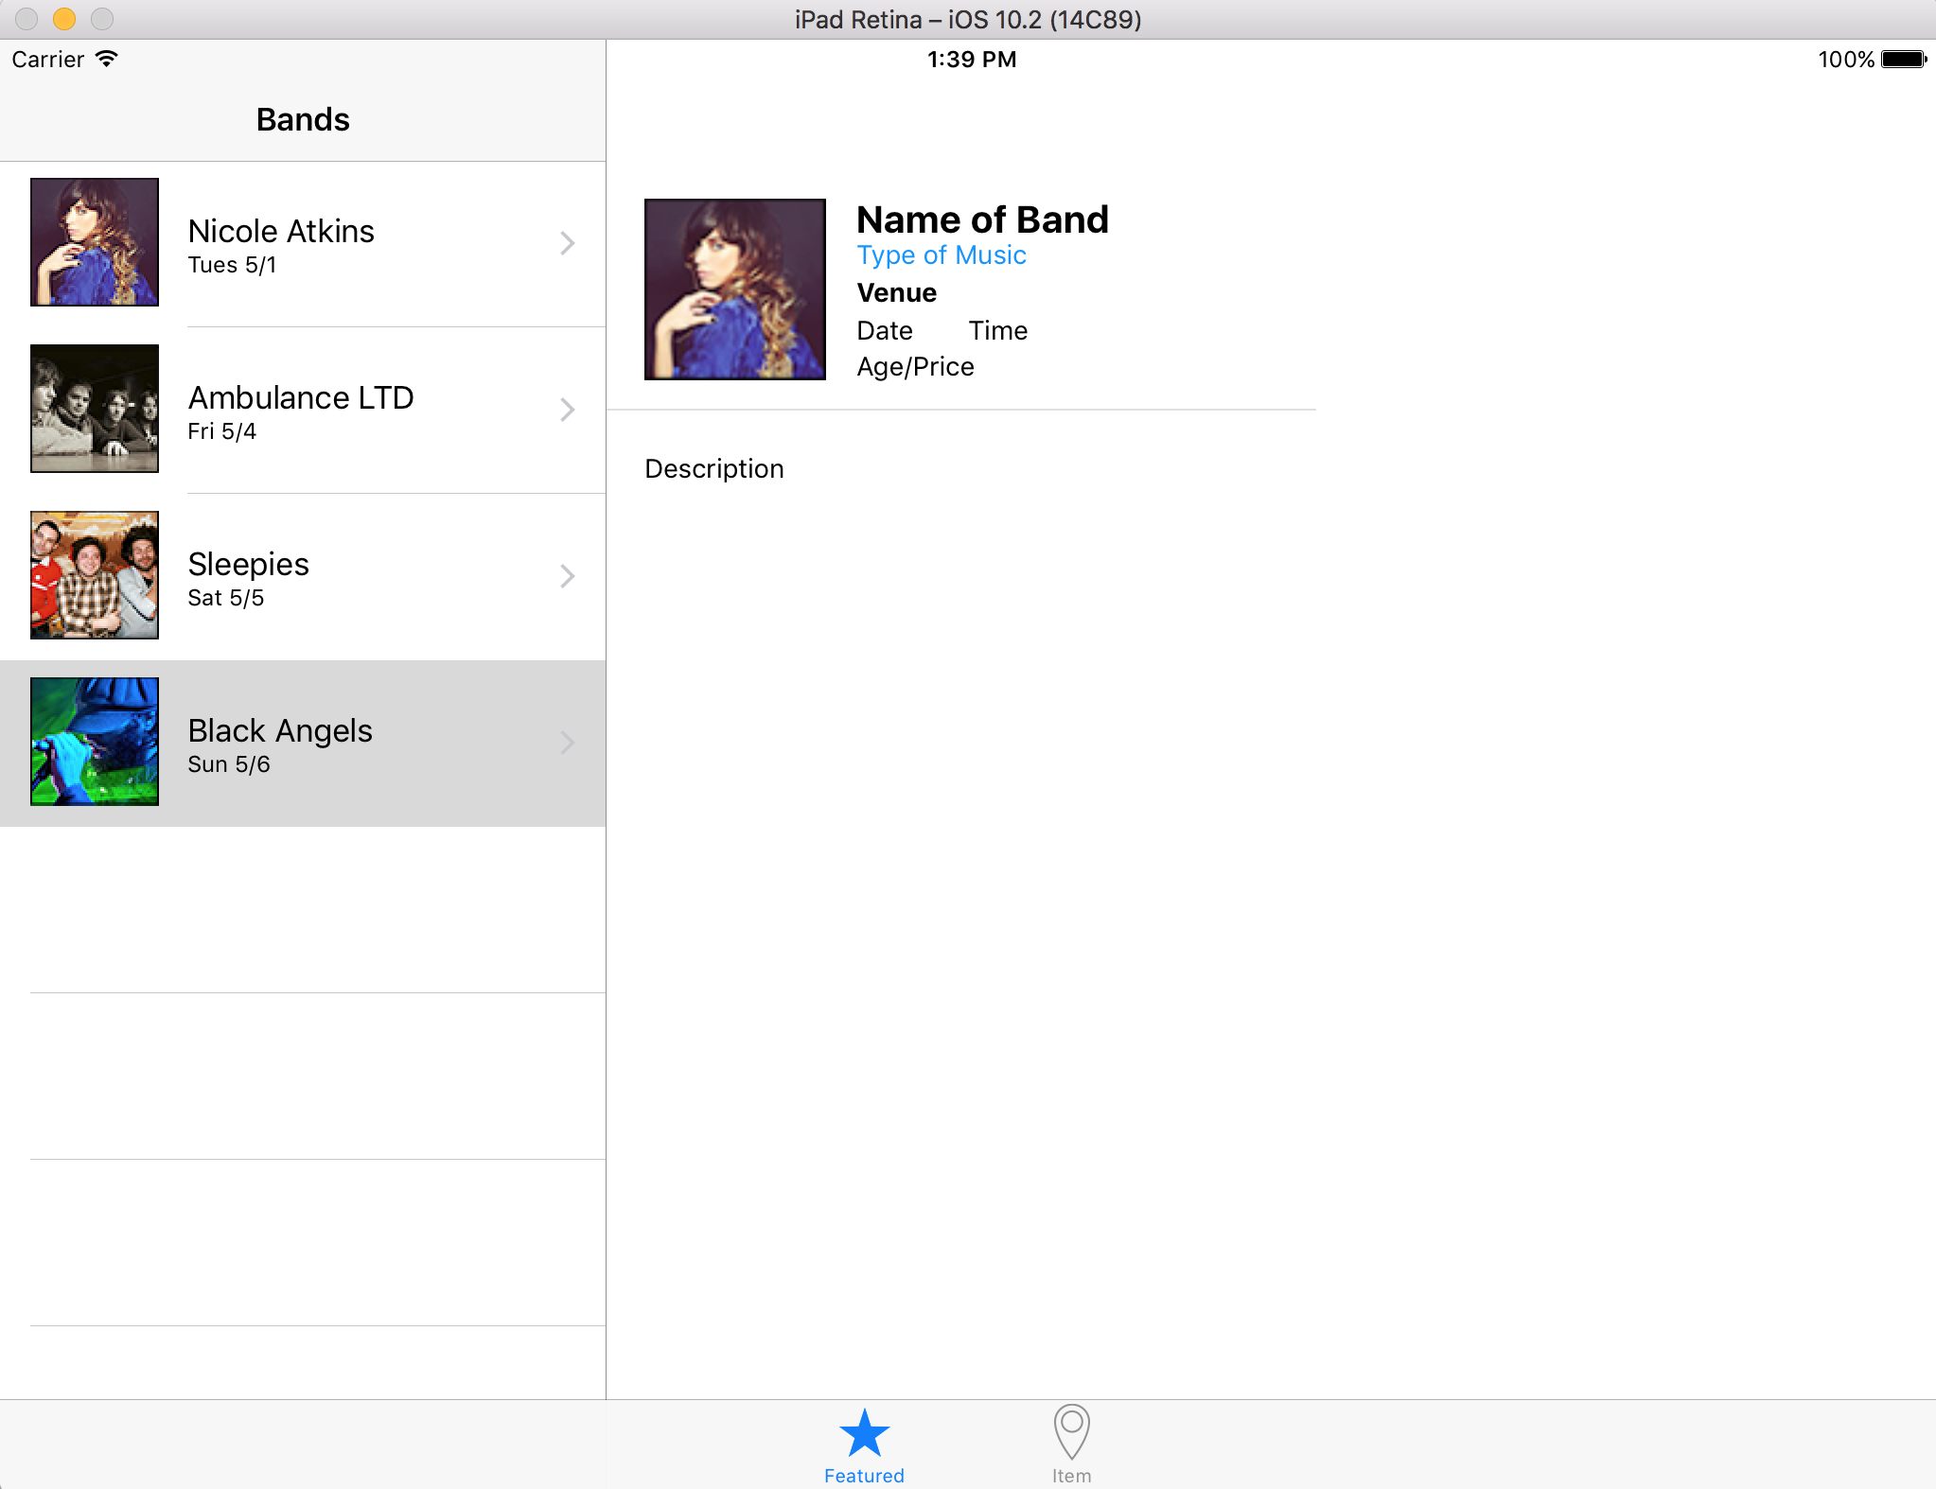
Notes:
In the Project Navigator, go to BandsDetailViewController.swift.
6. In order for this to run correctly, we’ll need to comment out the code in the
viewDidLoad method for now.
Select the code around lines 28–39, as shown in bold:
override func viewDidLoad() {
super.viewDidLoad()
// Do any additional setup after loading the view.
bandNameLabel.text = currentBandDetail?.bandName
bandTypeLabel.text = currentBandDetail?.bandType
venueLabel.text = currentBandDetail?.venue
CODE OMITTED TO SAVE SPACE
videoWebView.loadHTMLString(htmlString, baseURL: nil)
}
7. Hit Cmd–/ to comment out the code.
8. Click the Run button and hit Stop if a warning appears.

Slide 31
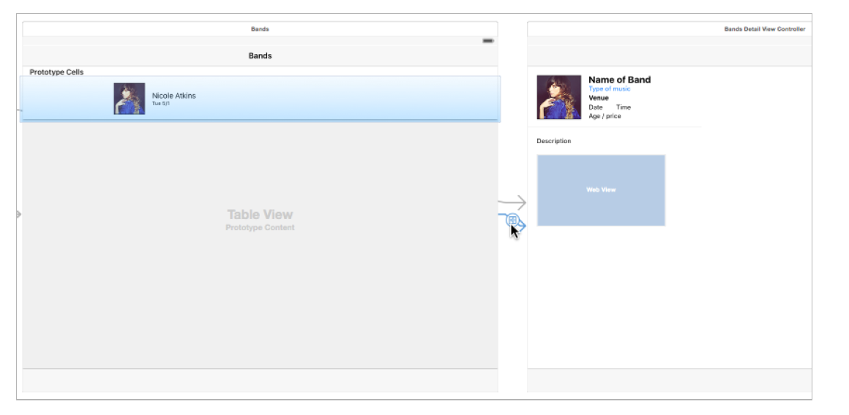
Notes:
Fixing the Table View
1. Switch back to Xcode.
2. In the Project Navigator, go to Main_iPad.storyboard.
3. Click on a blank area of the Editor to make sure nothing is selected.
As shown below, click on the segue (gray arrow with circle) between the Bands
Table View Controller and the Bands Detail View Controller to select it. (Make sure
you don’t select the arrow from the Split View Controller.)

Slide 32
Notes:
Fixing the Table View
1. Switch back to Xcode.
2. In the Project Navigator, go to Main_iPad.storyboard.
3. Click on a blank area of the Editor to make sure nothing is selected.
As shown below, click on the segue (gray arrow with circle) between the Bands
Table View Controller and the Bands Detail View Controller to select it. (Make sure
you don’t select the arrow from the Split View Controller.)
Click the Run button and click Stop if a warning appears.
7. When the Simulator finishes loading, click on one of the band rows. Notice we don’t
transition to our Detail View Controller here anymore. In the next exercise, we’ll get
the Detail View info displaying properly on the right.
8. Switch back to Xcode.
9. Click the Stop button.

Slide 33
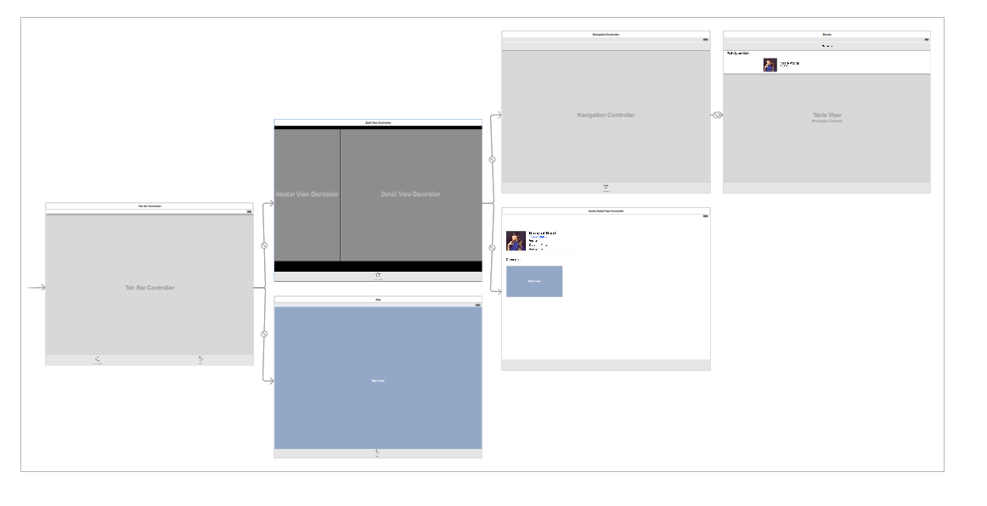
Notes:
Cleaning Up the Layout of the Controllers
1. As we’ve been working, the layout of the controllers in the Editor may have gotten a
bit messy. Rearrange the controllers into a layout that makes sense. We recommend
a layout like the one shown below

Slide 34
override func prepare(for segue: UIStoryboardSegue, sender: Any?) {
// Get the new view controller using segue.destinationViewController.
// Pass the selected object to the new view controller.
if (segue.identifier == "showDetail") {
if let indexPath = self.tableView.indexPathForSelectedRow { let bandsDetailViewController:BandsDetailViewController =
segue.destination as! BandsDetailViewController
let bandDetail = bandsModel.bandDetails[indexPath.row]
bandsDetailViewController.currentBandDetail = bandDetail
}
}
}
Notes:
In the Project Navigator, click on BandsTableViewController.swift.
2. Find the code for the prepareForSegue:sender: method (around line 136).
If you remember from a previous exercise, the prepareForSegue:sender: method is
called when we segue from the Table View Controller to the Bands Detail View
Controller. We use this method to pass along the information for each band to the
Table View Controller. The segue was also responsible for displaying the Detail View
Controller. We don’t have this segue in our iPad storyboard, so this method is never
called. We need to find another way to display the Detail View Controller and pass
along the details for each band.

Slide 35
// MARK: - Navigation
override func tableView(_ tableView: UITableView, didSelectRowAt indexPath: IndexPath) {
}
Notes:
In the Project Navigator, click on BandsTableViewController.swift.
Scroll down to around line 132, below the MARK: - Navigation comment, and add
the following method:
This method is called when a user taps on one of the band rows in the Table View
Controller, and will be perfect for passing along the band detail information.
However, one important thing to be aware of is that this code is being used for both
the iPhone and iPad versions of the app. The iPhone app is currently fine using just
the segue. We need to add some code so that the code in this method will only be
executed if the user is using an iPad.

Slide 36
// MARK: - Navigation
override func tableView(_ tableView: UITableView, didSelectRowAt indexPath: IndexPath) {
if (UIDevice.current.model.range(of: "iPad") != nil) {
}
}
Notes:
Now we have a place to pass along the band detail info for the iPad, but we still
need to pass that info to the Bands Detail View Controller in the SplitViewController.
Right now, only the SplitViewController has references to both the Master View
Controller (BandsTableViewController) and Detail View Controller
(BandsDetailViewController). We need to be able to reference the Detail View
Controller from the Master View Controller in the code.

Slide 37
let bandsModel = BandsModel()
var detailViewController:BandsDetailViewController!
override func viewDidLoad() {
Notes:
To do that, we will create a property in the BandsTableViewController class (Master)
that will reference the BandsDetailViewController (Detail). We’ll then assign the
BandsDetailViewController (Detail) reference in a SplitViewController class (which
we’ll create shortly) and set the property on the BandsTableViewController (Master).

Slide 38
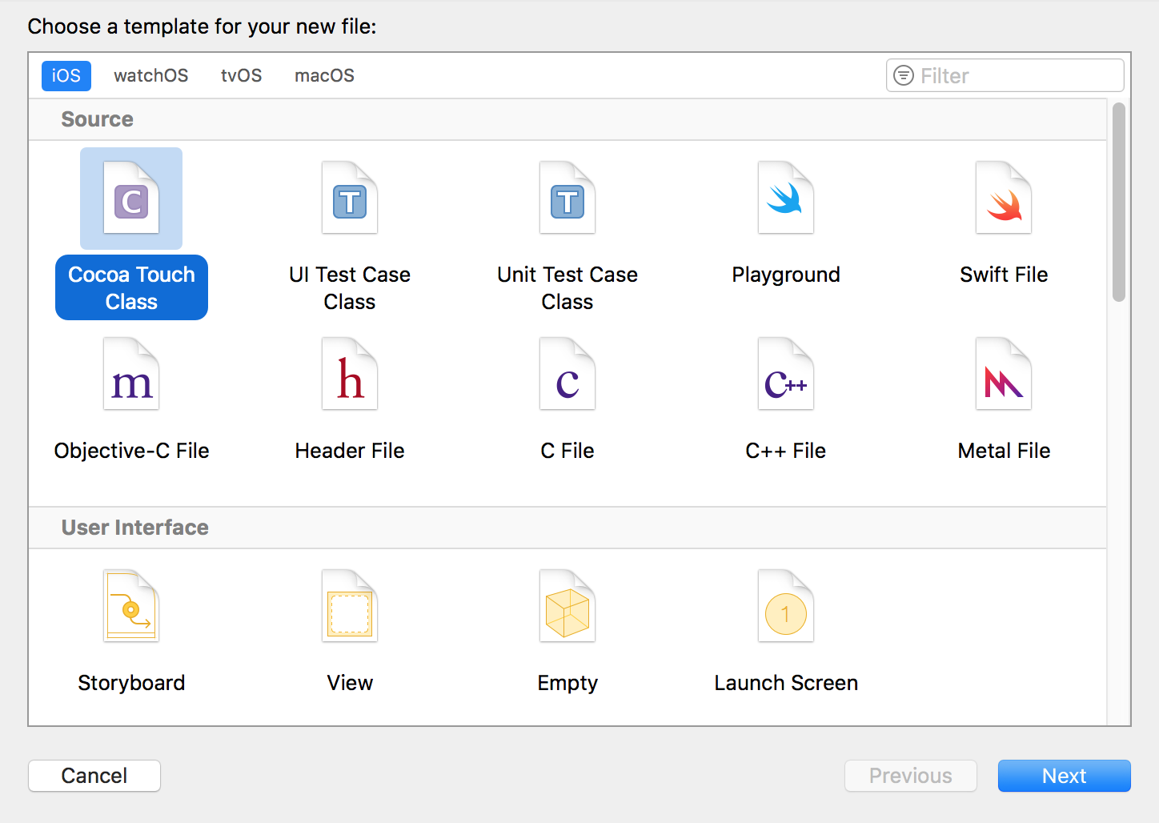
Notes:
Connecting the Master & Detail View Controllers
Now that we have a property we can use to reference the
BandsDetailViewController, we need to get into the code of the SplitViewController
and assign its Detail View Controller reference to our new property. To do that we
need to create a class and assign it to the existing Split View Controller on
the storyboard.
1. In the Project Navigator, select MapViewController.swift (so the new file will be
created after it).
2. Hit Cmd–N to create a new file.
3. On the left, under iOS select Source.
4. Double–click on Cocoa Touch Class to choose it.
From the Subclass of menu, choose UISplitViewController (or start typing it and let
Xcode autocomplete it for you).
6. Edit the name of the Class to be: MySplitViewController
7. Make sure Also create XIB file is NOT checked.
8. Make sure Language is set to Swift.
9. Click Next.

Slide 39
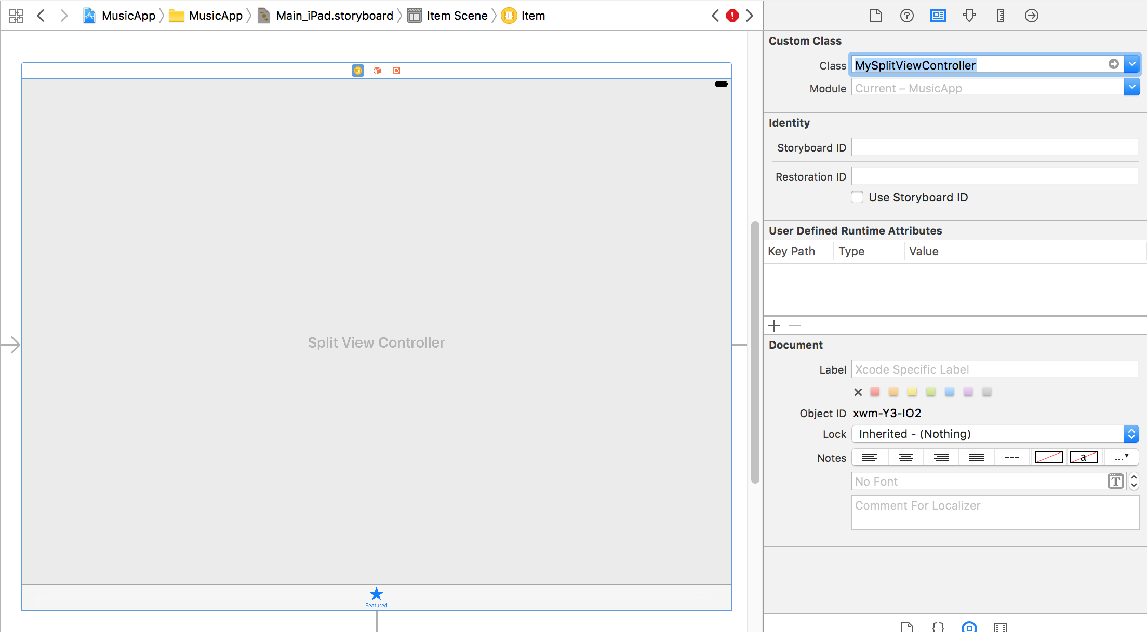
Notes:
In the Project Navigator, click on Main_iPad.storyboard.
13. Click on a blank area of the Editor so nothing is selected.
14. Select the Split View Controller so that it’s outlined in blue.
15. In the Utilities area, click on the Identity inspector tab .
16. Next to Class, type M and it should autocomplete to MySplitViewController.
Hit Return to apply it. Now it’s connected to the new class.

Slide 40
class MySplitViewController: UISplitViewController {
override func viewDidLoad() {
super.viewDidLoad()
let leftNavController = self.viewControllers.first as! UINavigationController let masterViewController = leftNavController.topViewController as! BandsTableViewController let detailViewController = self.viewControllers.last as! BandsDetailViewController masterViewController.detailViewController = detailViewController
}
Notes:
In the Project Navigator, click on MySplitViewController.swift.
18. Find the viewDidLoad method around line 13.
19. To save you some typing, we’ve already written the code that sets the views in the
split view. Go to File > Open.
20. Navigate to the Desktop > Class Files > yourname-iOS Dev Level 2 Class > Code
Snippets and open the file splitViewConnectMasterDetail.txt.
21. Press Cmd–A to select all the code.
22. Press Cmd–C to copy all the code.
23. Close the file.
182

Slide 41
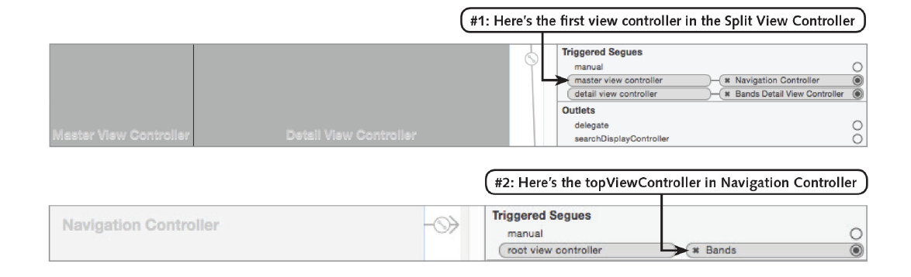
Notes:
This creates a property called detailViewController on our masterViewController so
we can set the current band when a row is tapped. It asks the masterViewController
to assign the view controller on the right to its detailViewController property. That
way we can tell the detailViewController which band to display after a tap.

Slide 42
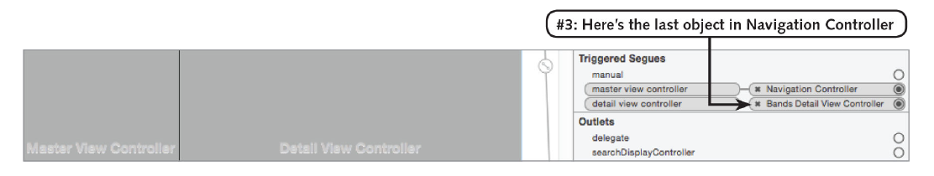
Notes:
The navigation controller has a stack of view controllers which is stored in an array.
The third line of code returns the BandsDetailViewController, as it is the last object
stored in that array (the last method grabs the last index of an array).

Slide 43
// MARK: - Navigation
override func tableView(_ tableView: UITableView, didSelectRowAt indexPath: IndexPath) {
if (UIDevice.current.model.range(of: "iPad") != nil) {
let bandDetail = bandsModel.bandDetails[indexPath.row]
}
}
Notes:
Now we have a place to pass along the band detail info for the iPad, but we still
need to pass that info to the Bands Detail View Controller in the SplitViewController.
Right now, only the SplitViewController has references to both the Master View
Controller (BandsTableViewController) and Detail View Controller
(BandsDetailViewController). We need to be able to reference the Detail View
Controller from the Master View Controller in the code.

Slide 44
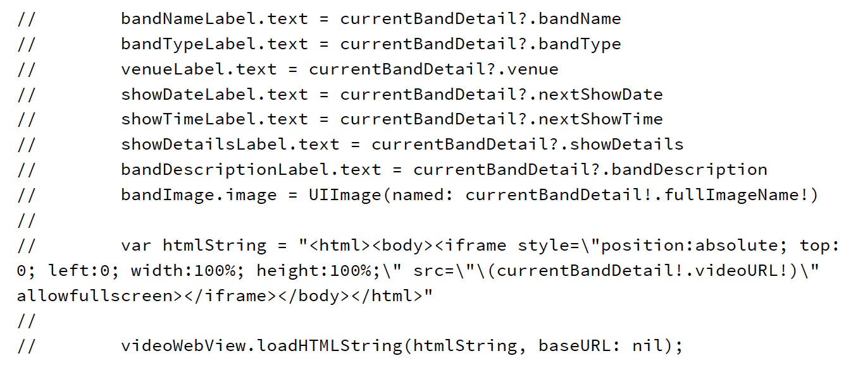
Notes:
In the Project Navigator, click on BandsDetailViewController.swift.
2. Find the viewDidLoad method (around line 24).
The view is currently being updated in the viewDidLoad method of the Bands Detail
View Controller. It takes all the values from the currentBandDetail and sets them on
the appropriate outlet for the view. This worked before for iPhone because each time
a row was selected, it used a segue, which created a new view controller. Therefore,
the viewDidLoad was called and it changed the labels.
Right now, in the iPad design, we’re using a Split View Controller, which only creates
the Master and Detail View Controllers once. We’re setting a new currentBandDetail
each time a row is selected, and we need the view updated every time that happens,
not just when the Band Detail View Controller is created.
In order to do this, we need to move the code from the viewDidLoad method (that
sets the band detail info) into a new method we can call anytime.

Slide 45
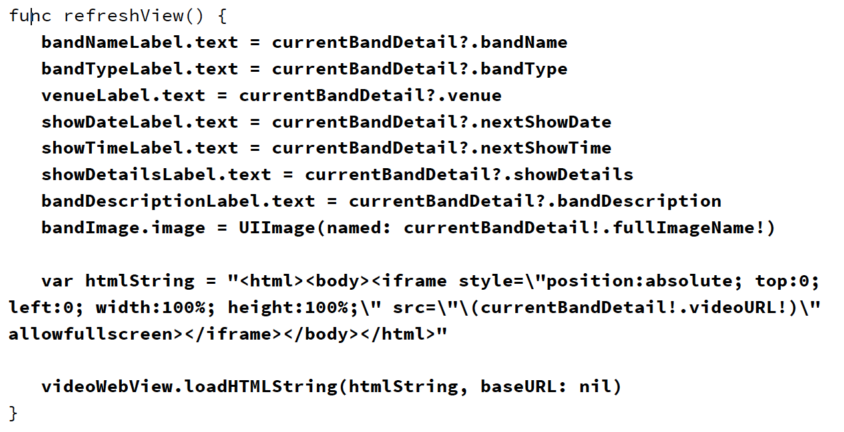
Notes:
Cut and paste the code from earlier view and put into func refreshView()

Slide 46
override func viewDidLoad() {
super.viewDidLoad()
if (UIDevice.current.model.range(of: "iPad") == nil) {
self.refreshView()
}
}
Notes:
For the iPhone app we still need to run this code inside the viewDidLoad method.
Add the following bold code to the viewDidLoad method, replacing the
comment line:

Slide 47
if (UIDevice.currentDevice().model.rangeOfString("iPad") != nil) {
var bandDetail = bandsModel.bandDetails[indexPath.row]
detailViewController.currentBandDetail = bandDetail
detailViewController.refreshView()
}
Notes:
In the Project Navigator, click on BandsTableViewController.swift.

Slide 48
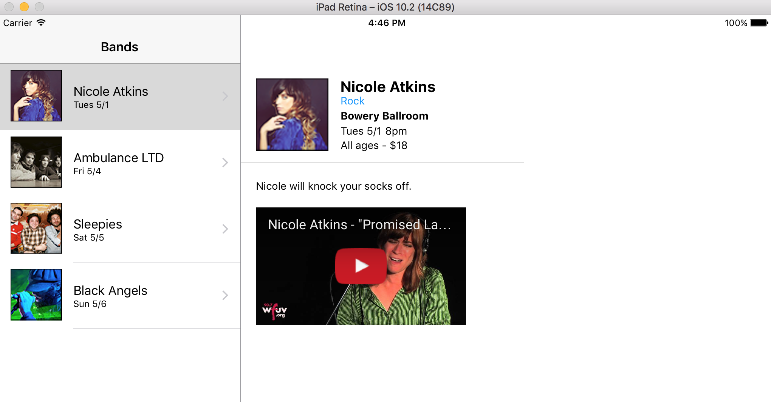

Slide 49
Agenda Next Week
Mid Term Exam sent before 2/28 class
Exam due Thursday 3/2 class
Project Demo Thursday 3/2

